Slide 1


Slide 2
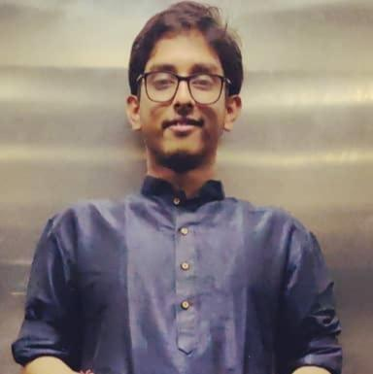
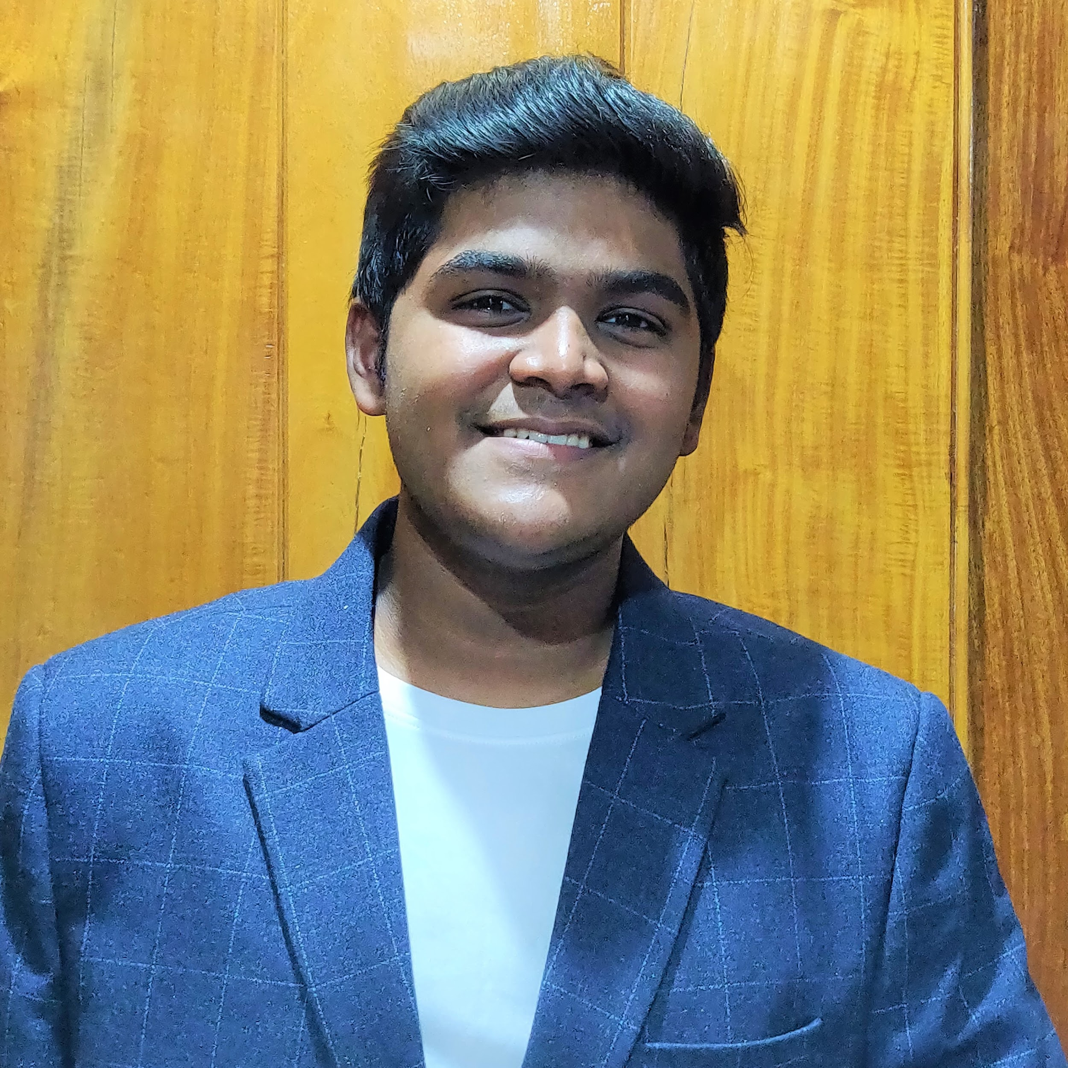
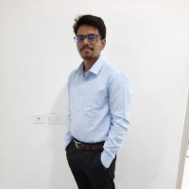
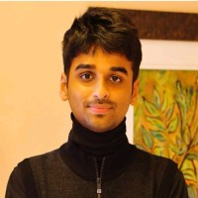

team deluminators
SANJIBAN SENGUPTA
ANANYA APRAMEYA
SOURAV KUNDA
DEBRUP DUTTA
/kahanikaar
/aprameya20
/07souravkunda
/xzayvian
Team Lead
Machine Learning
Project Concept
Backend Development
Project Design
Operations & Logistics
Application Development
Backend Development
Project Concept
Scripting
Documentation
Project Design
IIIT BHUBANESWAR

Slide 3
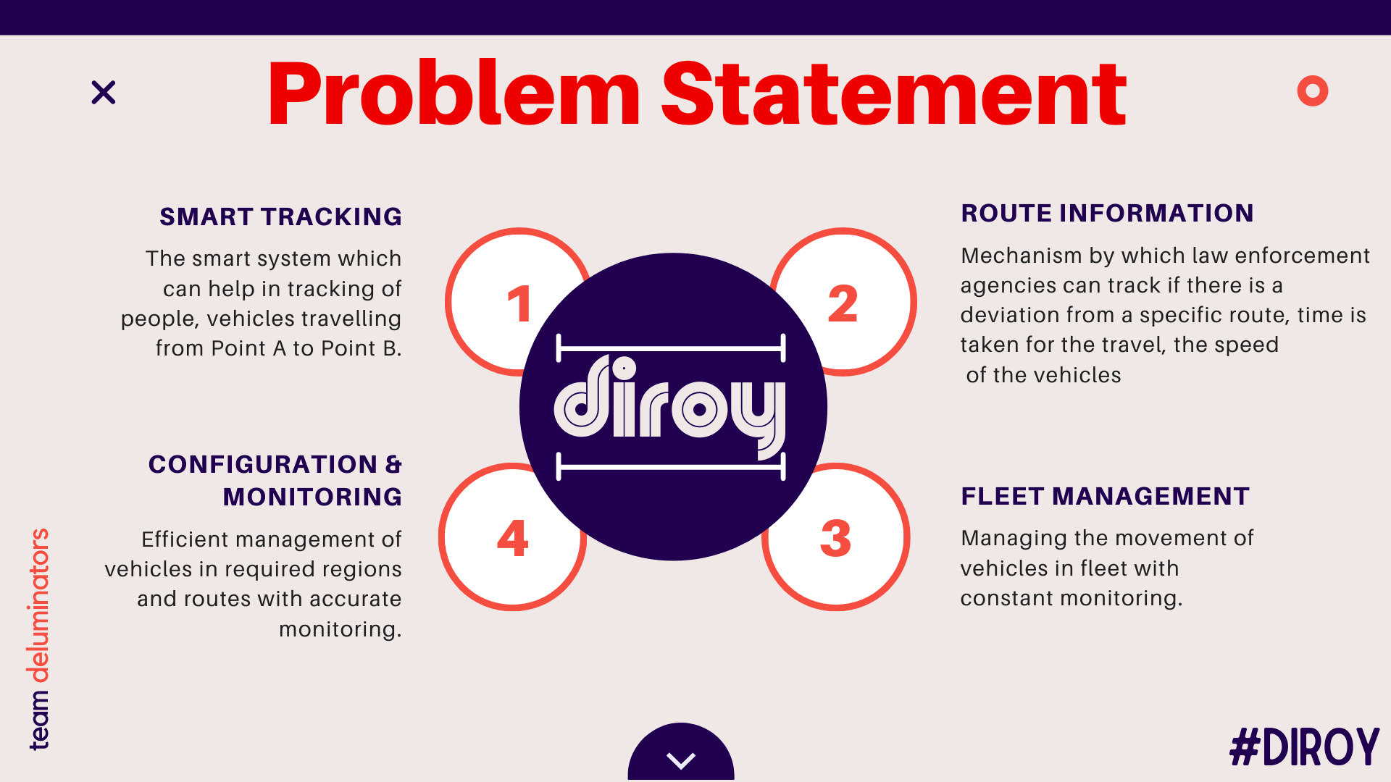

Slide 4
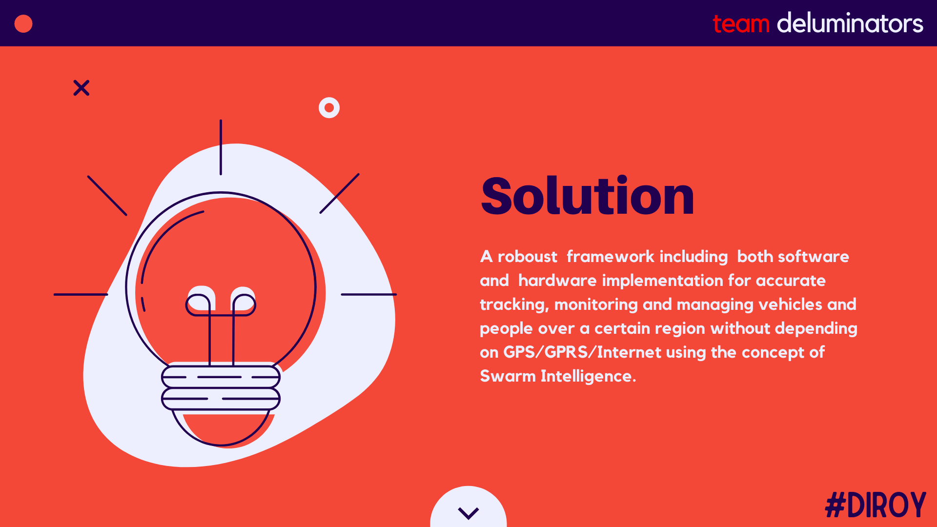

Slide 5
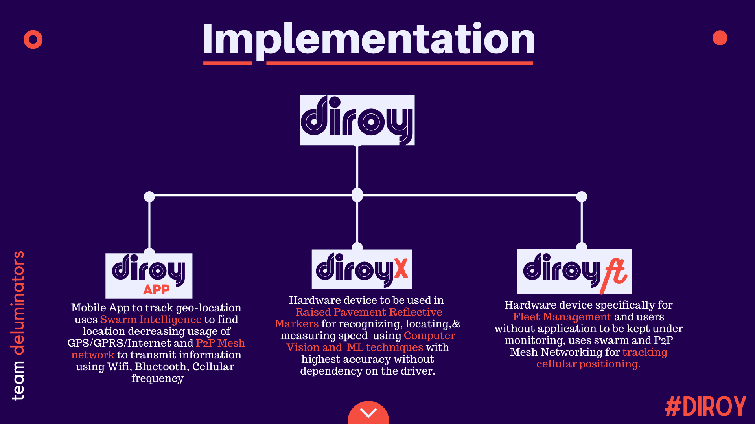

Slide 6
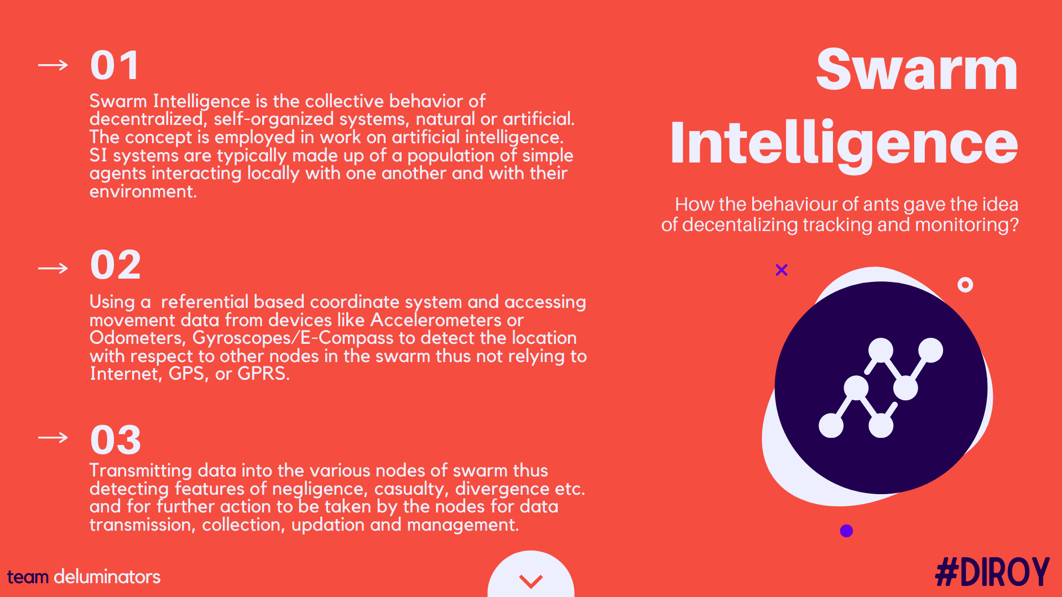

Slide 7
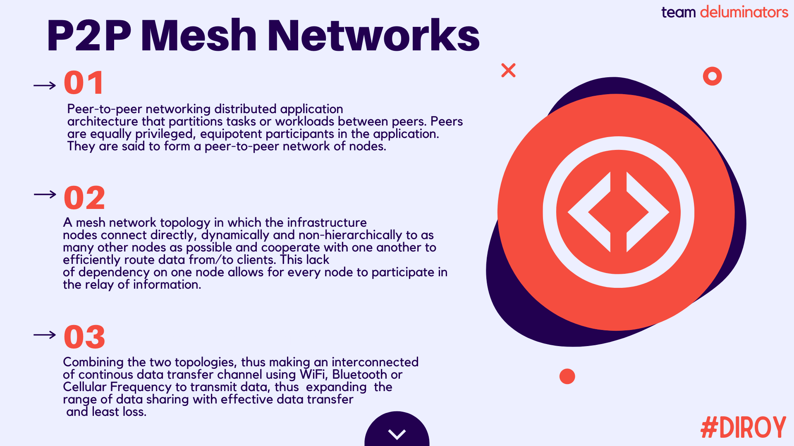

Slide 8
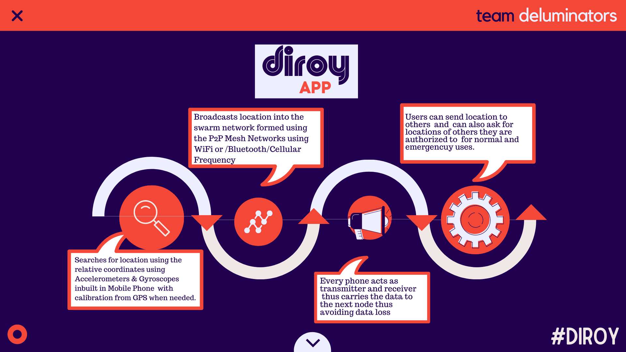

Slide 9
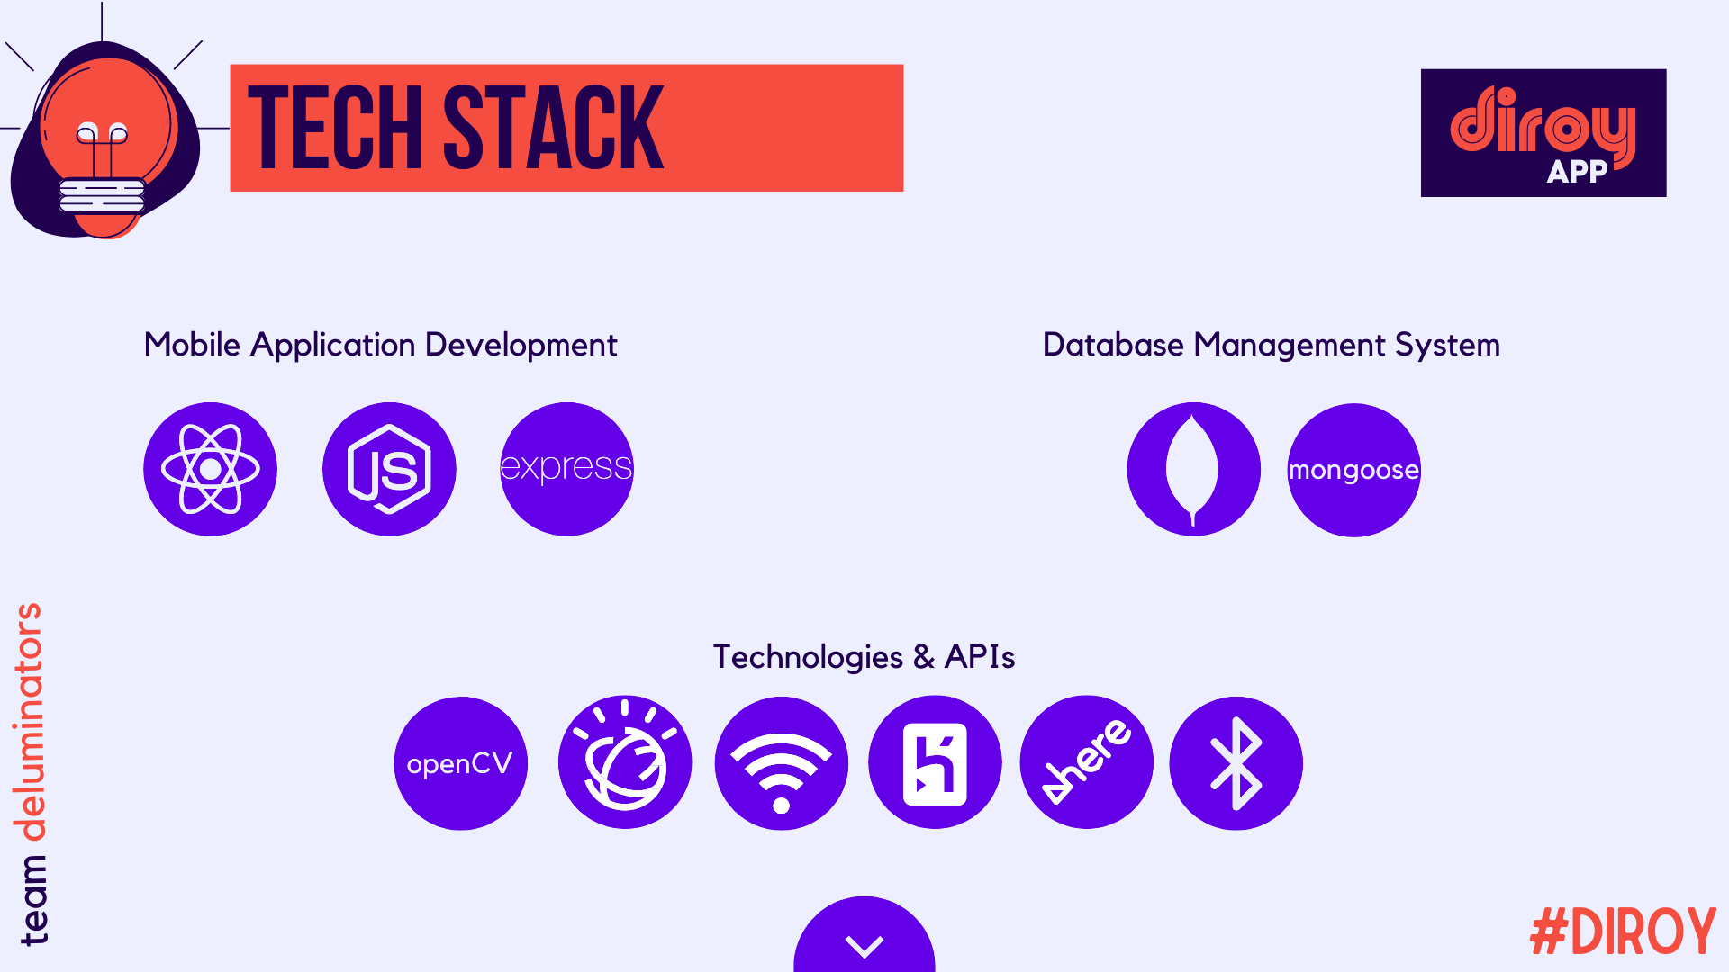

Slide 10
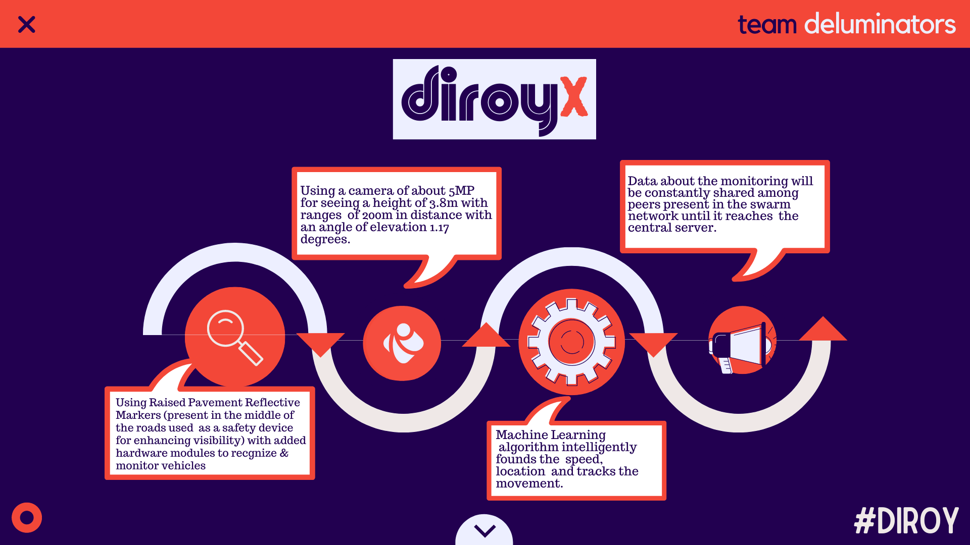

Slide 11
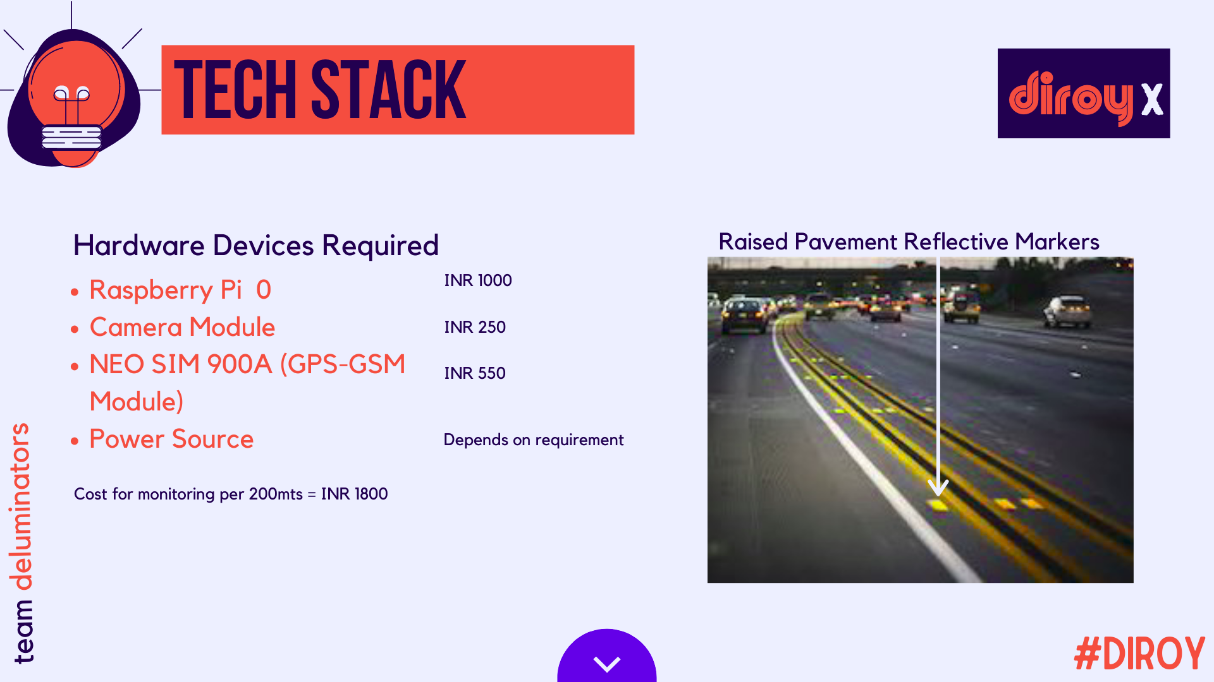

Slide 12
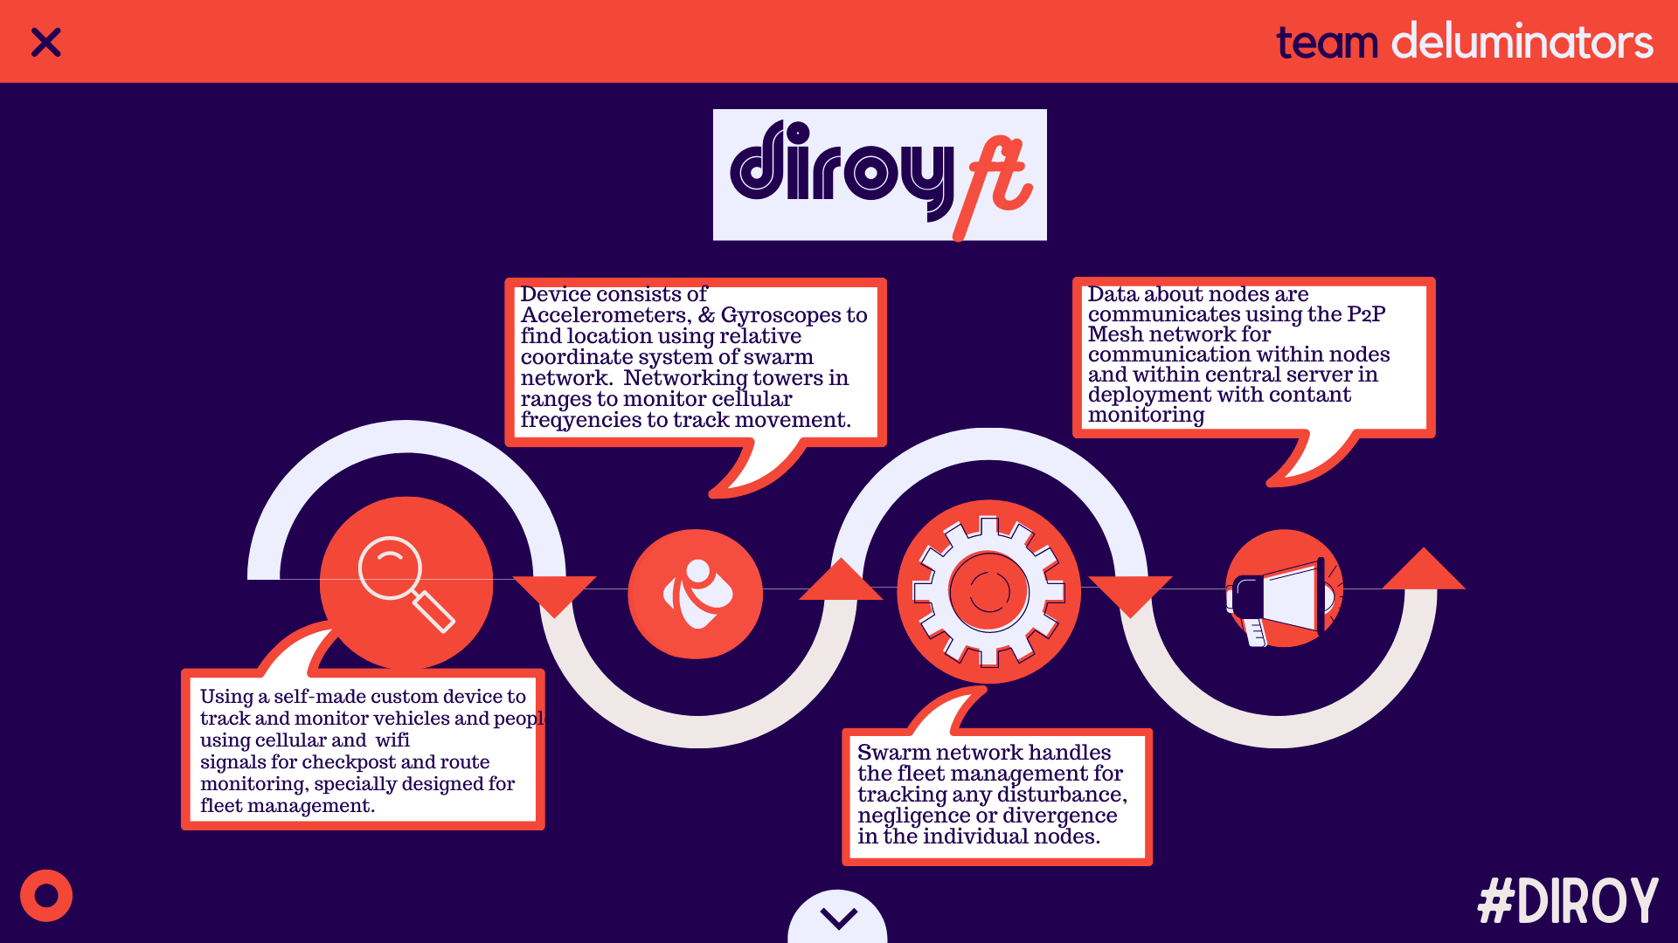

Slide 13
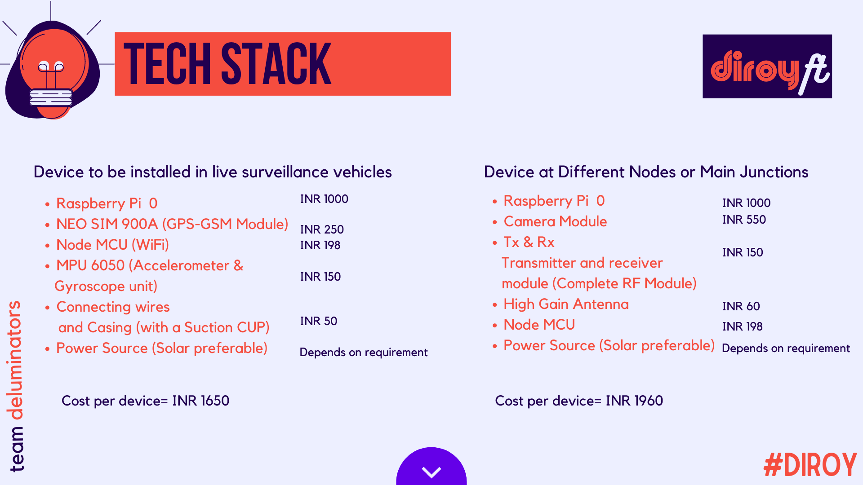

Slide 14

Github Repository Link: https://github.com/deluminators/Diroy
Demo Video Link: https://drive.google.com/drive/folders/1vr492zOsBTlQQhCEpUKsQsrATaepo2Zf?usp=sharing
Android Application Download:
https://drive.google.com/file/d/1xKlb1CJYdbRLezJk0iGM1_z_LdQoTtlf/view?usp=sharing

